Slide 1
↑
W
A
←
↓
→
A
S
D
X
R
Space
T
S
A
M
1
2
3
4
5
A
1
2
3

Slide 2


L
R

Slide 3













Slide 4





Slide 5
Resume
Play
Dialogue
Instructions
Back
Next
Quit

Slide 6




Tab

Slide 9
Kill All Enemies!

Recover Health

Slide 10
Layers of Dreams
Layers of Dreams

Slide 11
You Died...

Slide 12
X
R

Slide 13
Layers of Dreams

Slide 14
COMP30019
Graphics and Interactions
Project 2

Slide 15
Created by:
Ken Lin
Weng Kuan Kwok
Yannan Li
Yuhao Zong

Slide 16
Thank You!

Slide 17
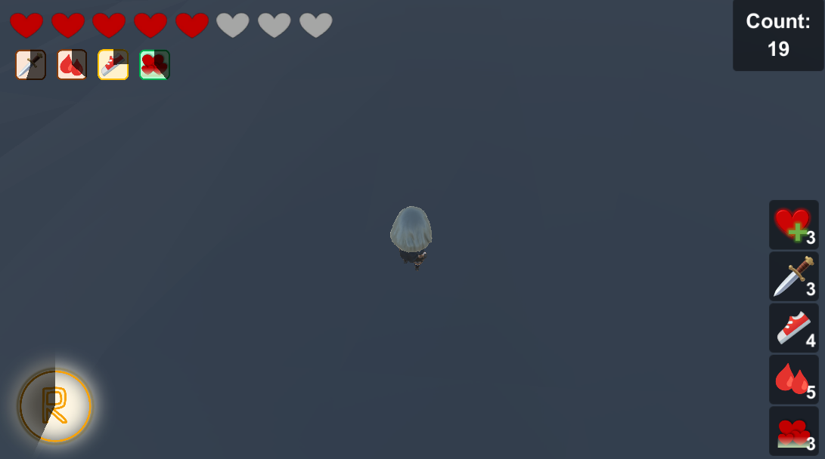



Health bar
Enemy Count
Buff Duration
Skill Cool Down


Item Inventory

